Slide 1
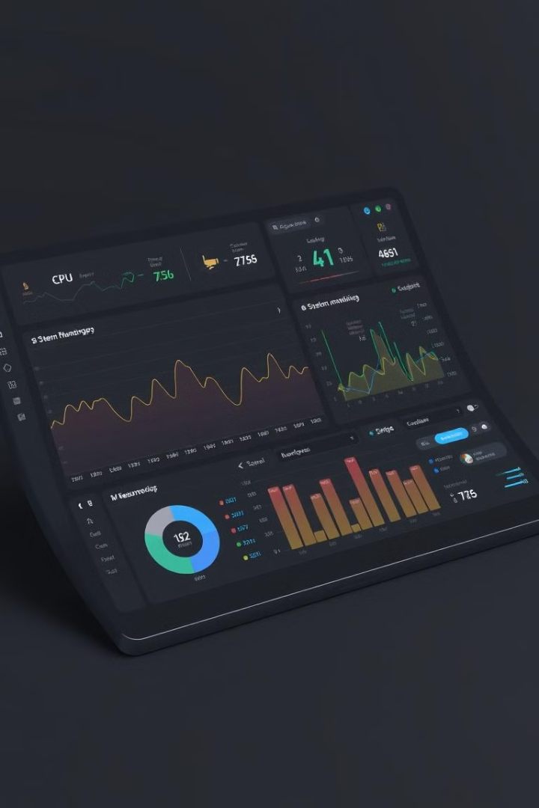
System Monitoring Bot: Leveraging RPA for Performance Insights
The System Monitoring Bot utilizes Robotic Process Automation (RPA) to gather vital performance insights from your computer system. This automation streamlines the process of monitoring and analyzing system data, empowering you to make informed decisions about your system's health and optimize its performance.

Slide 2
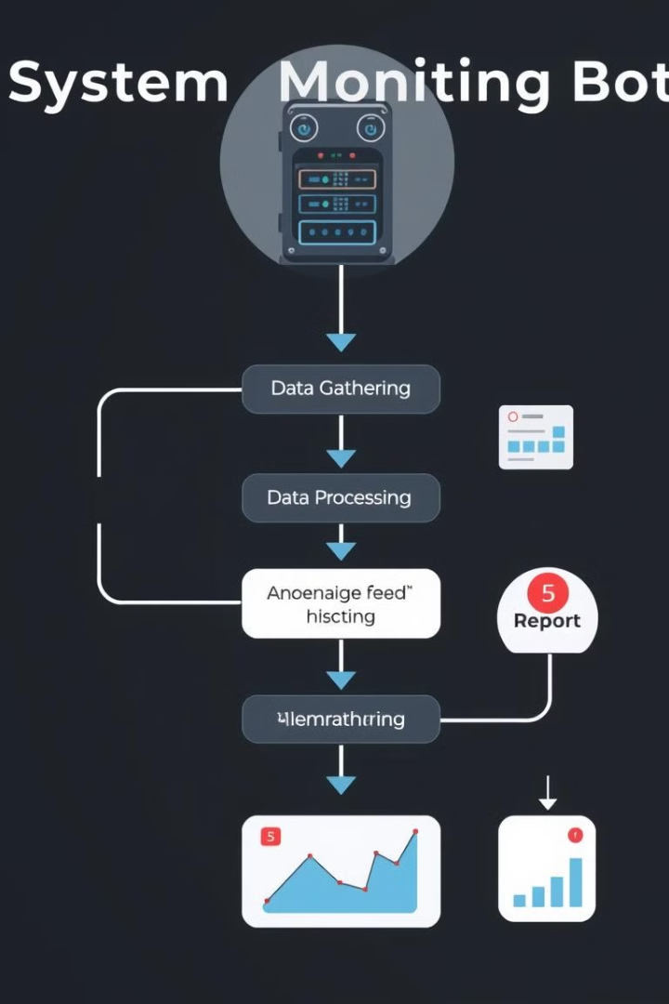
Project Overview: Automating CPU, Memory, and Time Tracking
1
CPU Usage
The bot uses the command prompt to gather real-time data on CPU usage.
2
Memory Usage
The bot gathers data on RAM usage.
3
Time Tracking
The bot tracks the time each data point is collected.

Slide 3

Gathering Data via Command Prompt
1
Command Prompt
2
Performance Data
The bot utilizes built-in commands to retrieve data from the system.
The bot accesses CPU and memory usage information.
3
Time Stamp
The bot records the exact time each data point is collected.

Slide 4
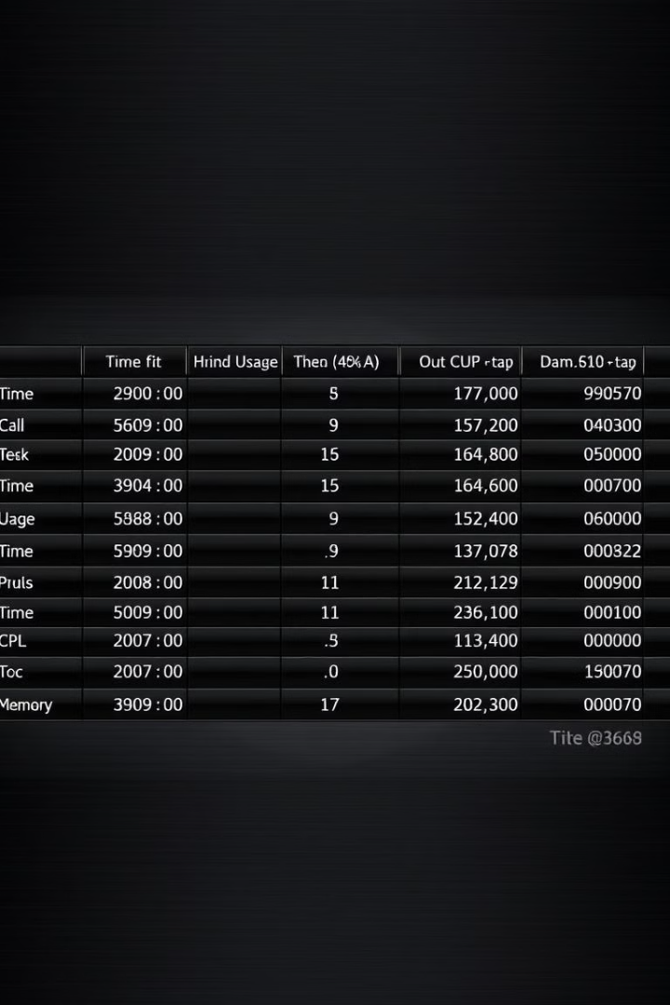
Storing Data in an Excel Sheet
Data Organization
Excel Format
The bot stores the collected data in a structured format.
Data is stored in columns for time, CPU usage, and memory usage.
Automated Process
The bot automatically updates the spreadsheet with new data.

Slide 5
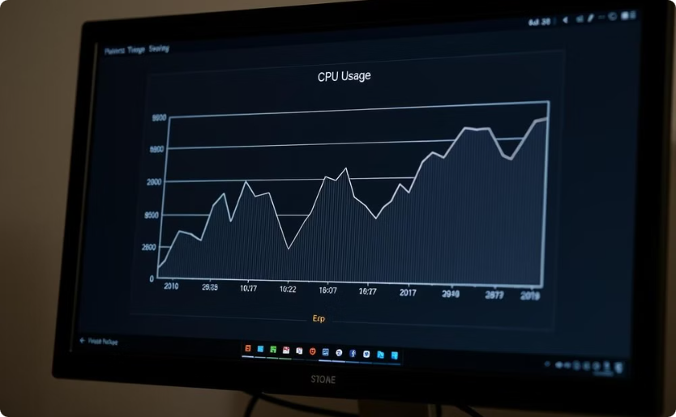
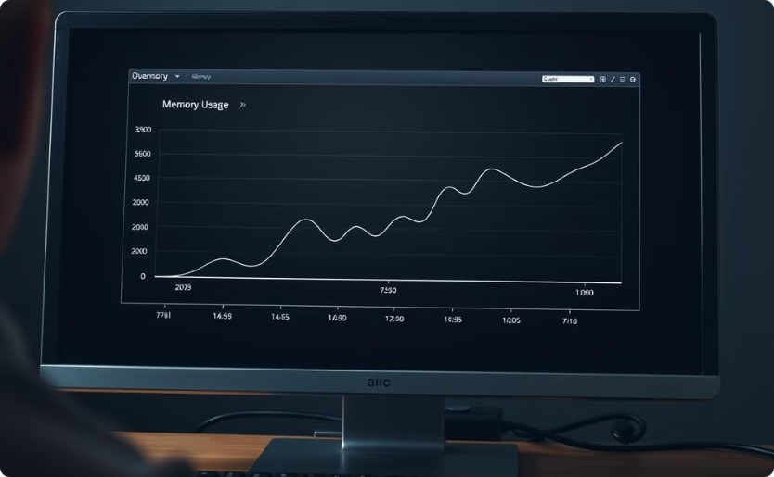
Visualizing Trends with Graphs
CPU Usage Graph
Memory Usage Graph
The bot creates a line graph that visualizes CPU usage patterns.
The bot creates a line graph that visualizes memory usage patterns.

Slide 6




Emailing Performance Reports
Automated Email
The bot generates an email containing a summary of the data.
Performance Data
The email includes an attachment with the detailed Excel data.
Scheduled Reports
The bot delivers reports on a regular schedule, such as daily or weekly.

Slide 7
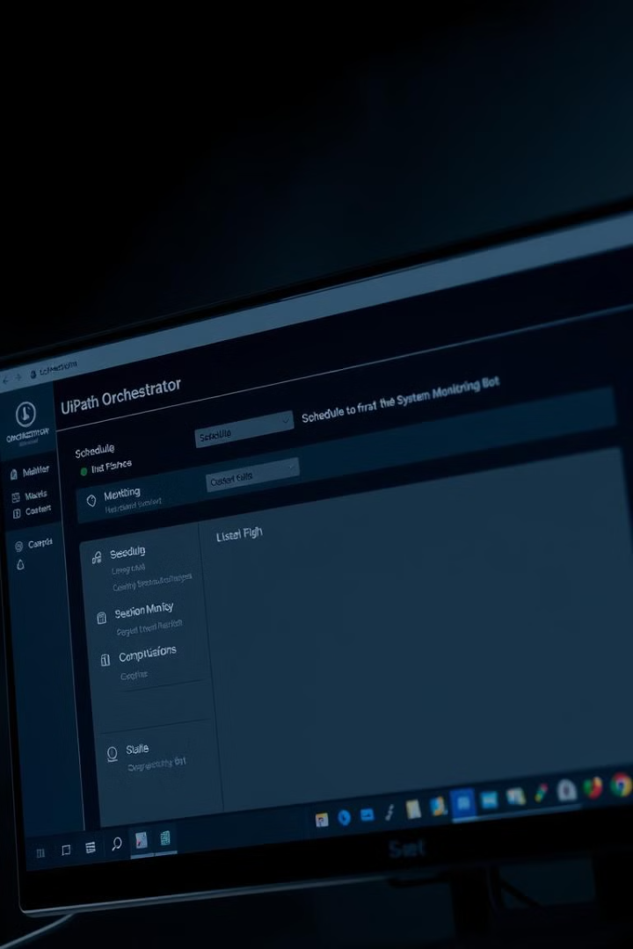



Orchestrator: Scheduling and Monitoring the Process
Automated Scheduling
The bot runs on a set schedule to gather and analyze data.
Real-time Monitoring
The Orchestrator provides real-time insights into the bot's performance.
Notifications
The Orchestrator sends alerts if any issues occur during the bot's operation.

Slide 8

Conclusion and Next Steps
The System Monitoring Bot automates performance monitoring for efficient system management.
Future enhancements include expanding data gathering to include disk space, network usage, and user activity.
The bot can be integrated with other monitoring tools for a holistic view of system health.

